Slide 1

SIM300C Training
Shao Yuguo
Feb 28, 2006

Slide 2

Agenda
1: Overview
2: Hardware enhanced features
3: Software enhanced features
4: Discussion

Slide 3

Contents
Overview
Hardware enhanced features
Software enhanced features
Discussion

Slide 4
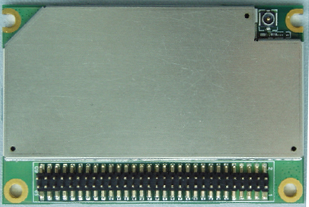
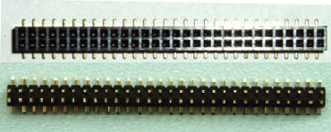
SIM300C Overview

Slide 5

SIM300C Overview
1:Tri-band(900/1800/1900) GPRS Class10
2: 50x33x6.2mm 60-pin DIP connector
3: Sleep mode
4: Embeded TCP/IP with transparent mode
5: Autobauding
6: Improved ESD/EMI performance
7: Over-temperature automatic shutdown
8: SIM card presence detection function
9: Battery charging interface

Slide 6
Contents
Overview
Hardware Features
Software Features
Discussion

Slide 7
Hardware Features
PIN NO. | PIN NAME | I/O | PIN NO. | PIN NAME | I/O
2 | GND |  | 1 | VBAT | I
4 | GND |  | 3 | VBAT | I
6 | GND |  | 5 | VBAT | I
8 | GND |  | 7 | VBAT | I
10 | GND |  | 9 | VBAT | I
12 | ADC1 | I | 11 | CHG_IN | I
14 | VRTC | I | 13 | TEMP_BAT | I
16 | Network LED /GPIO12 | O | 15 | VDD_EXT | O
18 | KBC0 | O | 17 | PWRKEY | I
20 | KBC1 | O | 19 | STATUS | O
22 | KBC2 | O | 21 | GPIO5 | I/O
24 | KBC3 | O | 23 | BUZZER | O
26 | KBC4 | O | 25 | VSIM | O
28 | KBR0 | I | 27 | SIM_RST | O
30 | KBR1 | I | 29 | SIM_I/O | I/O

Slide 8
Hardware Features
32 | KBR2 | I | 31 | SIM_CLK | O
34 | KBR3 | I | 33 | SIM_PRESENT | I
36 | KBR4 | I | 35 | GPIO32 | I/O
38 | SPI_EN | O | 37 | DCD | O
40 | SPI_CLK | O | 39 | DTR | I
42 | SPI_DO | I/O | 41 | RXD | I
44 | SPI_AO | O | 43 | TXD | O
46 | SPI_RESET | O | 45 | RTS | I
48 | DBGRX | I | 47 | CTS | O
50 | DBGTX | O | 49 | RI | O
52 | AGND |  | 51 | AGND
54 | MIC1P | I | 53 | SPK1P | O
56 | MIC1N | I | 55 | SPK1N | O
58 | MIC2P | I | 57 | SPK2P | O
60 | MIC2N | I | 59 | SPK2N | O

Slide 9

Hardware Features
Turn On SIM300C
SIM300C can be turned on by following method:
Using PWRKEY pin
RTC (alarm mode)

Slide 10
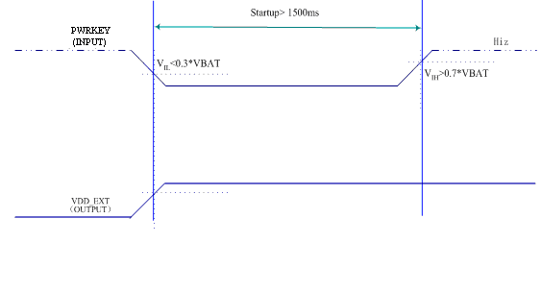
Hardware Features
Turn on SIM300C using the PWRKEY pin

Slide 11
Hardware Features
Turn on SIM300C using the RTC (Alarm mode)
The alert function of RTC will wake up the SIM300C while the module is power off.
AT command used in alarm mode
at+calarm set alarm time
at+cclk set current time
at+cfun start/shut protocol stack

Slide 12
Hardware Features
Power Off SIM300C
Using PWRKEY pin
Using AT command (AT+CPOWD=1)
Under-voltage auto shutdown
Over-temperature auto shutdown

Slide 13
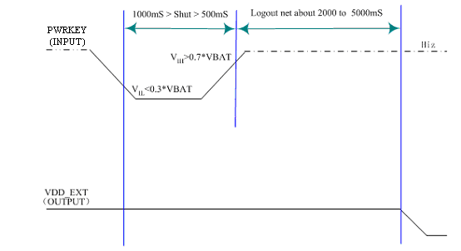
Hardware Features
Turn off SIM300C using the PWRKEY pin

Slide 14
Hardware Features
Under-voltage automatic shutdown
SIM300C firmware will constantly monitors the voltage applied on the VBAT, the following URC will be presented according to measured battery voltage:
POWER LOW WARNING (if VBAT<3.5V)
POWER LOW DOWN (if VBAT<3.4V)

Slide 15
Hardware Features
Over-temperature automatic shutdown
The uncritical temperature range is -40℃ to 90℃. If the measured temperature is equal or beyond this range, the module will be automatic shutdown soon.
Over-temperature Alarm
+CMTE:1 (>85℃)
+CMTE:-1 (<-35℃)
Over-temperature auto shutdown
+CMTE:2 (>90℃)
+CMTE:-2 (<-40℃)

Slide 16
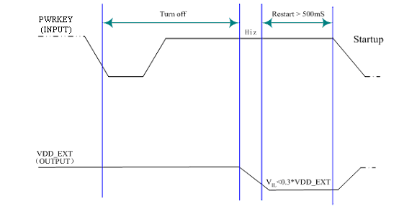
Hardware Features
Restart SIM300C using PWRKEY

Slide 17
Hardware Features
RTC backup interface---VRTC(pin14)
A coin-cell battery or a super-cap to PIN 14 enables backup power
supply for RTC.
DC CHARACTERISTICS
Vmax=2.0V
Vmin=1.2V
Vnorm=1.8V
Inorm= 20uA

Slide 18
Hardware Features
Power Saving
Minimum functionality mode
Sleep mode (Slow clocking mode)

Slide 19
Hardware Features
Minimum functionality mode
Enter minimum functionality mode
at+cfun=0(4)
Wakeup from minimum functionality mode
at+cfun=1

Slide 20
Hardware Features
Sleep mode (Slow Clocking mode)
Enter sleep mode
at+csclk=1 and keep DTR high
Wakeup from sleep mode
Pull DTR low
Receive an SMS or incoming call
RTC alarm expired

Slide 21
Hardware Features
Serial interfaces
Uart 1
TXD RXD RTS CTS DTR DCD RI
Uart 2
DBGTX DBGRX

Slide 22
Hardware Features
Serial interfaces
TXD (internal pull up) and RXD
DTR (internal pull up)
sleep mode control
switch from data mode to command mode

Slide 23
Hardware Features
Serial interfaces
DCD (default level is high)
drives low when an TCP/UDP connect established during transparent mode
drives low when a PPP connection established

Slide 24
Hardware Features
Serial interfaces
RI (default level is high)
Drives low when received an incoming call (data or voice) or SMS

Slide 25
Hardware Features
Serial interfaces
RTS (internal pull down)
Used for hardware flow control. Pulling RTS high will disable transmission from module and pulling RTS low will enable transmission from module.

Slide 26
Hardware Features
Serial interfaces
CTS
Used for hardware flow control. CTS low indicates the module is ready to transmit data, default level is low.

Slide 27
Hardware Features
Serial interfaces
Autobauding (1200-115200)
Factory setting is enabled, no URCs appears when power on.
You must wait for 8s and then send the first string like AT and waiting for about 1s for synchronization.
AT+IPR? -→ +IPR:0
AT+IPR=X;&W (save the configuration)
Next time when you power module, URCs appears.

Slide 28
Hardware Features
Audio interfaces
Speaker interface
Microphone interface

Slide 29
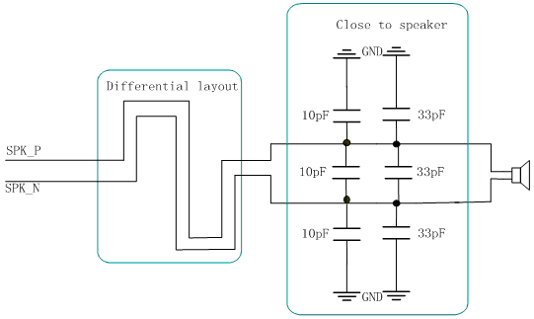
Hardware Features
Speaker interface

Slide 30
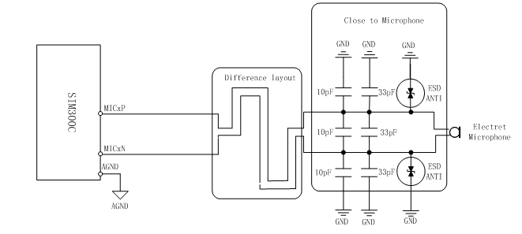
Hardware Features
Microphone interface

Slide 31
Hardware Features
MIC input DC characteristic
Parameter | Min | Typ | Max | Unit
Working Voltage |  | 1.25 | 2.5 | V
Working Current | 5 |  | 300 | uA
External Microphone Load Resistance | 1.2 | 2.2 |  | k Ohms

Slide 32
Hardware Features
Audio output DC characteristic
Parameter |  |  | Min | Typ | Max | Unit
Normal Output(SPK1) | Single Ended | load Resistance | 27 | 32 |  | Ohm
 |  | Ref level |  |  | 1.0954 | Vpp
 | Differential | load Resistance | 27 | 32
 |  | Ref level |  |  | 0.5477 | Vpp
Auxiliary Output(SPK2) | Single Ended | load Resistance | 27 | 32 |  | Ohm
 |  | Ref level |  |  | 1.0954 | Vpp
 | Differential | load Resistance | 27 | 32
 |  | Ref level |  |  | 0.5477 | Vpp

Slide 33
Hardware Features
AT commands for audio interface
AT+CHFA switching audio channels
AT+CLVL adjusting speaker volume
AT+CMIC adjusting microphone gain
AT+CRSL adjusting buzzer volume
AT+ECHO adjusting echo suppression parameters
AT+SIDET setting side tone level

Slide 34
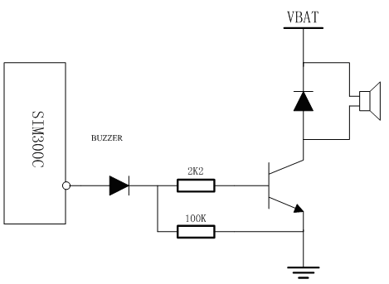
Hardware Features
Buzzer interface

Slide 35
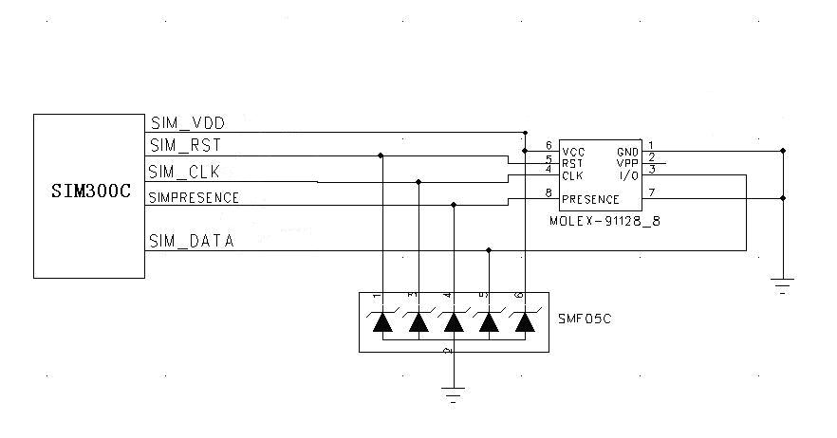
Hardware Features
SIM card interface(8-pin SIM card holder)

Slide 36
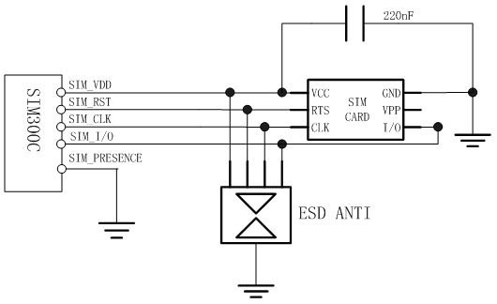
Hardware Features
S IM card interface(6-pin SIM card holder)

Slide 37
Hardware Features
Electro-static discharge
Part | Contact discharge | Air discharge
VBAT,GND | ±8KV | ±10KV
KBR0-4, DTR, RXD, TXD, RTS, SPI_DATA, SPI_CLK | ±4KV | ±8KV
Antenna port | ±8KV | ±8KV
Other port | ±4KV | ±8KV

Slide 38
Hardware Features
Charger interface (Li-Ion Battery)
Related pins: CHG_IN, VBAT, TEMP_BAT
Main states in whole charging procedure:
DDLO charge and UVLO charge;
Fast charge;
Trickle charge;

Slide 39
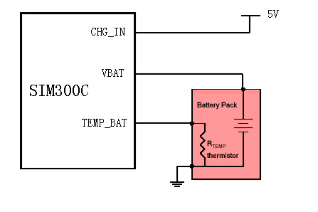
Hardware Features
Charger interface (Li-Ion Battery)

Slide 40
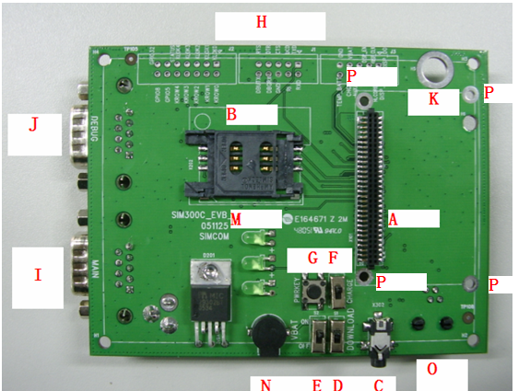
EVB and Firmware Update

Slide 41
Contents
Overview
Hardware Features
Software Features
Discussion

Slide 42
Software Features
Serial interface
Autobauding (1200-115200)
(Firmware:1008B05SIM300C32_SPANSION or newer)
First time when turn on module, no RDY and URCs
at+ipr? (query the current baudrate)
+ipr:0 (0 means autobauding enabled)
at+ipr=38400;&w (change the baudrate and save)
Next time when turn on module, RDY will appear

Slide 43
Software Features
Transparent mode (TCP/IP stack)
SIM300C supports Transparent Mode which provides a special data mode for data receiving and sending by TCP/IP application task. Once the connection is established under Transparent Mode, the module will be in data mode. All received data from serial port will be treated as data packet to be transferred later, similarly all data received from remote server will be sent to serial port directly. Methods are provided to switch back and forth between the data mode and command mode. Once switched to command mode, all AT commands can be used.

Slide 44
Software Features
Configure Transparent Mode
AT+CIPMODE=1 //select transparent mode
OK
AT+CIPCCFG=3,2,256,1 //configure the mode: retry 3 times if
sending failed
//wait for 2*200ms to send one packet
//send data at once if there are 256 bytes in the buffer
//Escape sequence(+++) is allowed
AT&D1 //DTR pin is allowed to switch serial port from data mode to
command mode

Slide 45
Software Features
Startup a TCP connection
AT+CIPSTART=”TCP”,”222.66.38.187”,”5000” //startup a TCP
connection
OK
CONNECT //Connection is established, serial port is in data mode
//and DCD pin will goes low

Slide 46
Software Features
Switching from data mode to command mode
1: +++
To use this sequence, there should be 500ms idle period before and
after this sequence. Besides, the interval between each + should not
exceed 20ms, otherwise it will be treated as TCP/IP data.
2: Pull DTR low
If switched successfully, OK will be returned.

Slide 47
Software Features
Switching from command mode to data mode
ATO command
If switched successfully ,CONNECT will be returned.

Slide 48
Software Features
Hardware flow control (CTS)
Hardware flow control is enabled under Transparent Mode. CTS pin of serial port will be deactivated (high) if a flow control is needed. Flow control will arise if the data buffer size is larger than 1/2 of the buffer size. When flow control arises, the module will still receive data from serial port. But if the received buffer overflows, module will not receive any data until there is enough buffer space. If the data buffered size is less than 1/4 of the buffer size, CTS will be activated (low) again.

Slide 49
Software Features
Handling incoming call and SMS in data mode
RI pin of serial port will give a 50ms low pulse when a call is incoming during data mode.
RI pin will give a 120ms low pulse when a short message is received.
To handle the incoming call or SMS, you need to enter command mode first (using DTR or +++), and then the module will give the normal unsolicited responses as following:
RING (incoming call)
+CMTI：”SM”，17 (short message)
And then it is able to answer the call or read the short message.

Slide 50
Software Features
Handling with errors
If an error occurs, for example if module’s TCP task failure while transmitting data or PDP context is deactivated from network, or remote server closes the TCP connection, serial port will be switched from data mode to command mode automatically, you can shut down the TCP/UDP connection using AT+CIPSHUT and restart the connection.
If module can not transfer data anymore in Transparent Mode, first use escape sequence (+++) or DTR pin to switch to command mode, then shut down the TCP/UDP connection using AT+CIPSHUT and restart the connection.

Slide 51
Software Features
Pins and at commands relate to transparent mode
Pins:
TXD
RXD
DTR switching from data mode to command mode
RI indicating new SMS or incoming call
DCD indicating TCP/UDP connection active
CTS indicating module UART receive buffer is nearly full
AT commands:
AT+CIPMODE select transparent mode
AT+CIPCCFG set TCP/UDP
ATO switching from command to data mode

Slide 52
Software Features
New added AT commands
at+cmte (measure temperature)
at+csdt (enable SIMcard presence detection)
at+csclk (enable sleep mode)
at+cipmode (selecting TCP/IP mode)
at+cipccfg (setting TCP/IP parameters)
at+cipscont (Save TCP/IP configurations)

Slide 53
Software Features
New added AT commands (cont’d)
at+cmgda (delete all SMS)
at+sclass0 (save flash SMS)

Slide 54
Contents
Overview
Hardware Features
Software Features
Discussion

